Slide 1
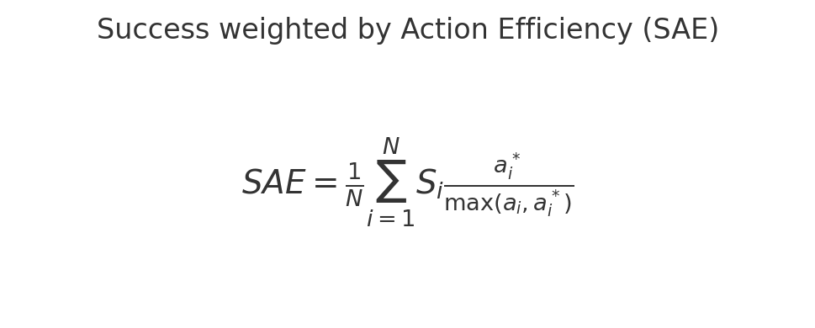
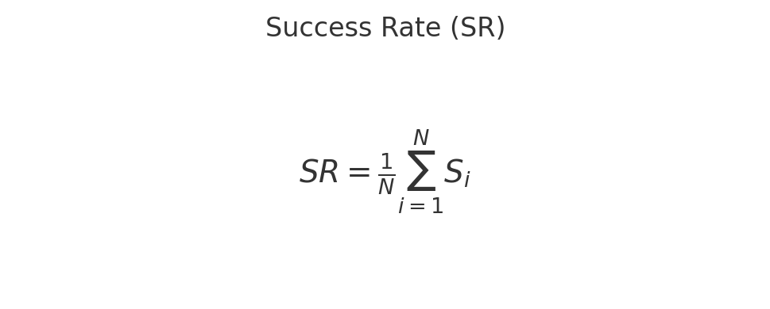
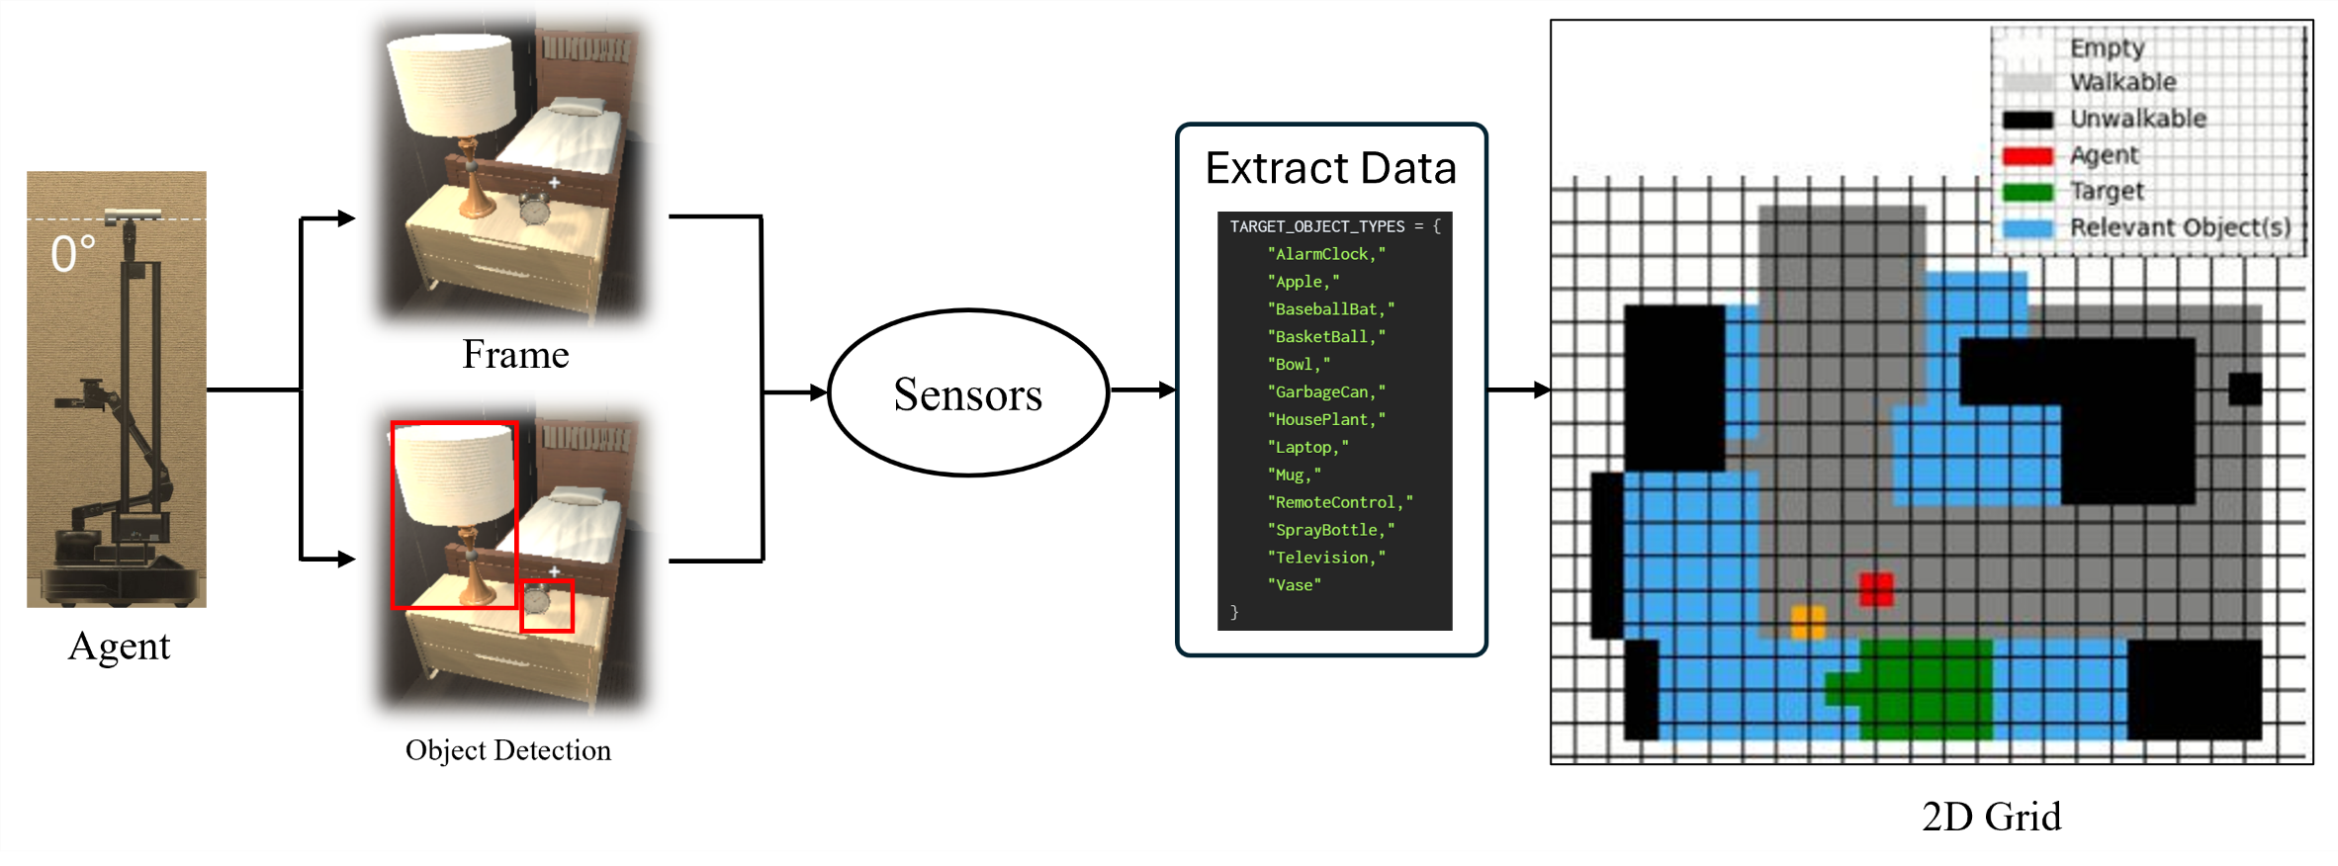
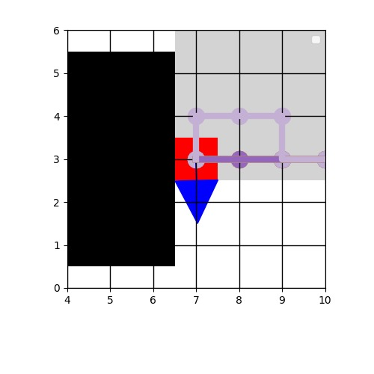
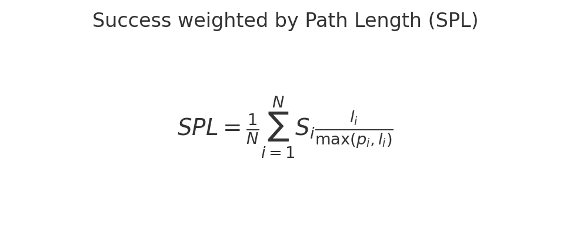
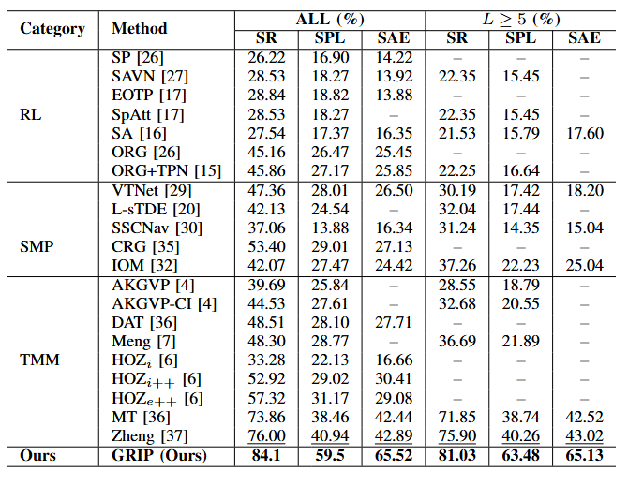
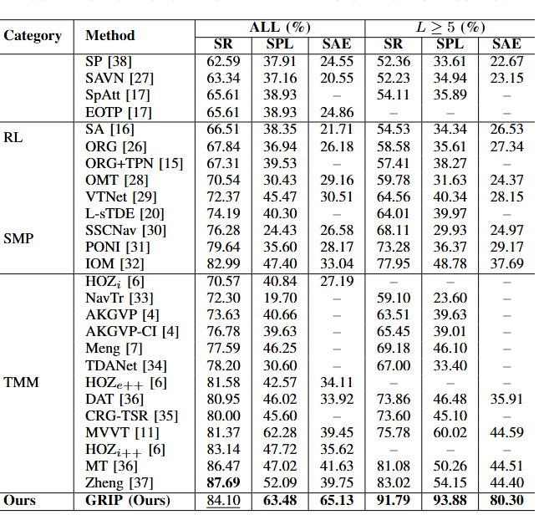
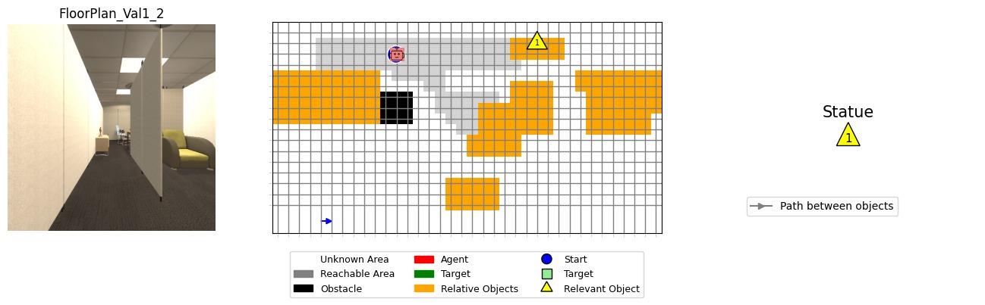
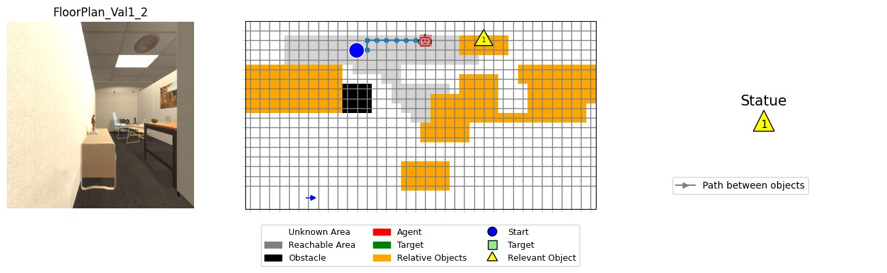
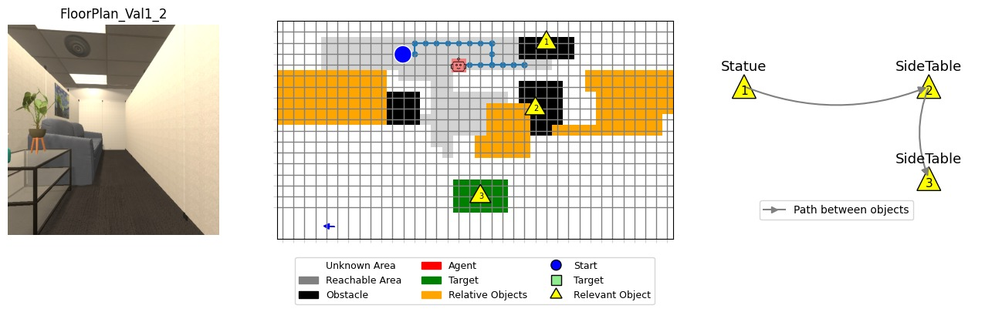
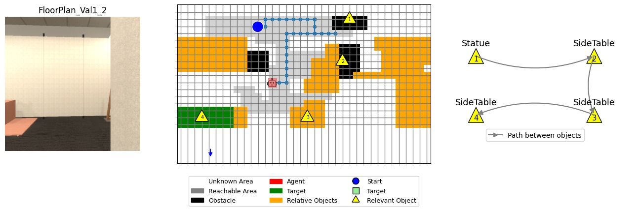
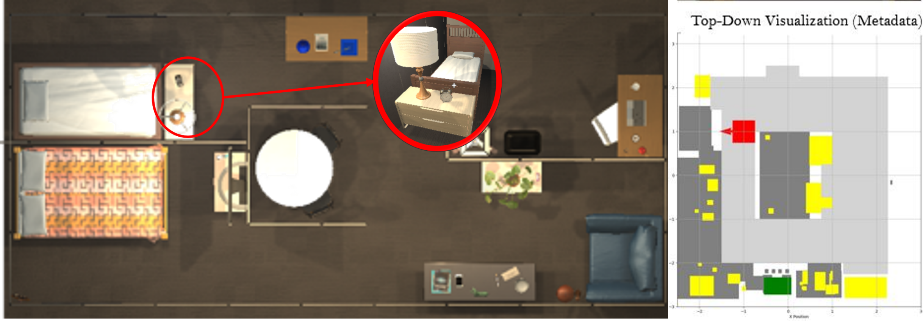
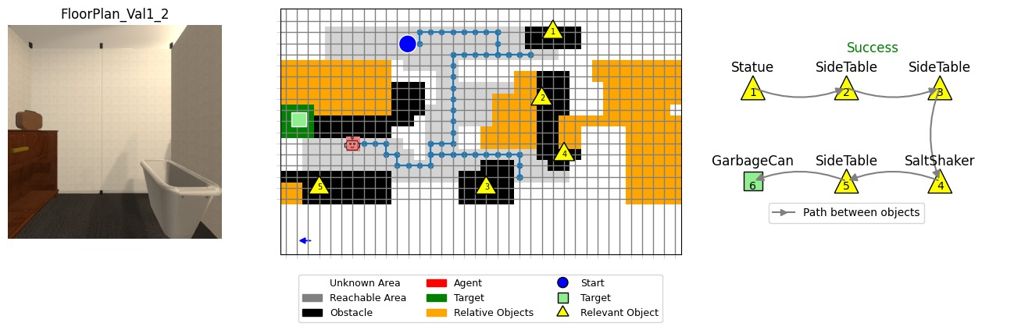
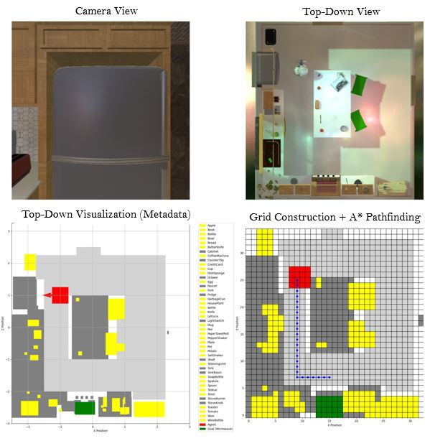
NavClone: Imitation Learning Enhanced Robot Navigation with 2D Grid
Ahmed Hamdan Alanazi
Computer Science,
University of Missouri at Kansas City,
INTRODUCTION & OBJECTIVES
RELATED WORK
METHOD
CONCLUSIONS
The evolution of autonomous robot navigation is driven by advancements that merge real-world robotics with virtual environments represented through two-dimensional grids. This integration relies on developments in computational models, Behavior Cloning (BC), and sophisticated path-planning algorithms. Our research introduces a robust framework that builds and utilizes a 2D grid representation of indoor spaces, applying the D-Star algorithm for initial path planning. Subsequently, Behavior Cloning techniques are employed, training the robot to interpret local sub grid scenarios and make informed navigation decisions such as moving straight, left, or right.
Environment Exploration: To enable robots to autonomously explore.
Grid Generation: Translating environmental data into structured two-dimensional grid.
Behavior Cloning Training: Training robots, enabling them to interpret local sub grid conditions.
2023 - Static maps or predefined policies, limiting their adaptability in situations requiring frequent recalculations.
2023 - Multi-view observations and additional constraints to improve navigation.
2024 - Rely on representational learning to extract and transfer spatial and semantic knowledge across environment.
2024 - complementary direction in robot navigation via group-aware reasoning.
Environment Exploration: The robot autonomously explores indoor environments using LiDAR, IMU, and camera sensors. Object detection techniques are employed to identify and categorize objects within the environment, ensuring comprehensive situational awareness.
Grid Generation: Our algorithm systematically constructs a structured two-dimensional grid from the sensor data collected during exploration. This grid precisely represents navigable paths, obstacles, and detected objects, and it is continuously updated with each movement of the robot to reflect real-time changes in the environment.
Behavior Cloning Training: From the generated grid, we extract consistent local sub grids, which serve as input frames for Behavior Cloning (BC) training. This approach allows the robot to learn from structured data and accurately predict navigation commands such as moving straight, turning left, or turning right, based on local environmental conditions.
Our research introduces a significant advancement in autonomous robot navigation by developing a novel framework that combines environment exploration, dynamic 2D grid generation, and behavior cloning. By effectively integrating sensor-based mapping with behavior cloning training, our approach bridges simulation and real-world application, significantly enhancing robotic navigation accuracy, adaptability, and decision-making capabilities in complex indoor environments.
RESULTS & EVALUATION
Table 1
Table 2
Comparison of State-of-the-Art Methods on the RoboTHOR Dataset. We report Success Rate (SR), Success-weighted Path Length (SPL), and Success-weighted Action Efficiency (SAE) for all navigation trajectories and long-horizon tasks (L <= 5). GRIP achieves the best results across all metrics
Performance Comparison on the AI2-THOR Dataset. We report Success Rate (SR), Success-weighted Path Length (SPL), and Success-weighted Action Efficiency (SAE) for both all navigation episodes and long-horizon episodes (L >= 5). GRIP consistently outperforms prior state-of-the-art methods in both categories.
Figure 1. 2D Grid Generation Framework
Figure 3. Sub Grid
DATASETS & SIMULATION
To comprehensively assess our framework's performance, we utilize standard robotics evaluation metrics: Success Rate (SR), Success weighted by Path Length (SPL), and Success weighted by Action Efficiency (SAE). SR measures the proportion of successful navigation tasks, SPL considers both the success rate and the efficiency of the path taken, and SAE evaluates the efficiency based on the actions performed. These metrics provide a holistic view of our framework's navigation accuracy, efficiency, and overall effectiveness in achieving designated navigation goals across various complex indoor environments Table1 & 2.
We evaluate our approach using the AI2-THOR simulation environment, specifically leveraging the iTHOR and RoboTHOR datasets. iTHOR provides over 100 realistic indoor environments categorized into kitchens, living rooms, bedrooms, and bathrooms. RoboTHOR offers a set of 75 scenes split into training (60), validation (15), and testing environments, specifically designed for benchmarking robotic navigation and interaction tasks. Utilizing these datasets ensures robust validation and comprehensive testing of our navigation framework across diverse and realistic scenarios.
A
B
C
D
Figure 4. Exploring and Generating a 2D Grid in Real Time
FUTURE WORK
Future research could focus on enhancing the robustness and adaptability of our framework by integrating reinforcement learning techniques with behavior cloning. Additional developments may include exploring multi-agent collaborative navigation and applying transfer learning to allow trained models to generalize effectively to diverse indoor environments with minimal additional training data.
CONTACT
Email: aha85b@umsystem.edu
Acknowledgments: We would like to thank our supervisor Dr Yugyung Lee and mentor Dr Duy Ho for their support.
Figure 2. Robothor Datasets Framework
Figure 5. Generated 2D grid from Robothor Dataset with a Success Case

